Slide 2
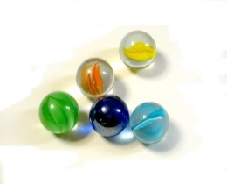
2.1 Skambalove (marble game)
Objectives
Counting to 36, by threes;
Arrangement and comparison of numbers to 36;
Summing one-digit and two-digits numbers;
Trajectory of moving objects (e.g. the length of the trajectory between two points of it);
Coordinate system;
Analytic geometry (e.g. partition of a segment in certain relation).
Tools, Materials and Organisation
Each player gets one marble.
Draw the field for the game.

Slide 3
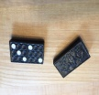
2.1 Skambalove
Description of the Lesson
First part of the lesson (15 minutes)
Gamе area is a rectangle shape on the ground with parameters 3x4m.
Each player chooses a marble.
The teacher explains the rules and the game begins.
Setting the turn of the players.
Players learn how to count from 1 to 36.
Players learn the geometric shapes rectangle, circle and sphere.
Players learn how to sum numbers up to three.
Second part of the lesson (30 minutes)
Hand out the worksheets to each person one.
Follow the instruction on the worksheet.
Useful Hints
Useful Hints
At the end of the lesson the worksheet is completed. If the participants cannot read, the teacher has to guide them. If participants have difficulties to count, you have to train – you need more time or you can split the group. The participants have to know to count to 36. The participants have to sum numbers in combination to 3 the numbers form 1 to 36.

Slide 4
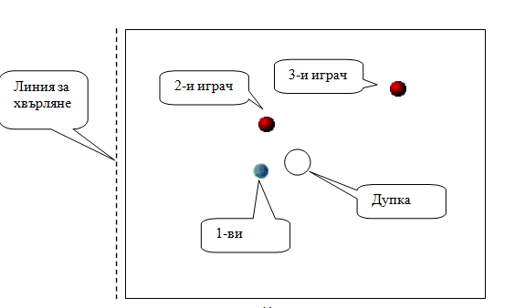
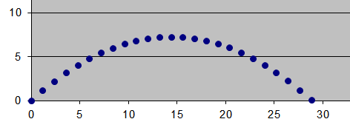
2.1 Skambalove
Phase 1: Find the playing order
In the beginning of the game the players stand further from the side of the hole in the rectangular. Each of them tosses his marble towards the hole, aiming to move it as close as possible to it or inside of it. The player whose marble is closest to the hole or gets inside of it begins first. Second in turn is the player with the second in distance marble, etc. This rotation order continues until the end of the game.
Phase 2: Play Marbles and Earn Points
After settling the sequence the first task of the players is to place their marbles in the hole. A hit in the hole counts for 3 points. After hitting the hole the player has the right to hit others players’ marbles. Each opponent’s marble hit counts for 3 points. Once after an opponent’s marble is hit, the player has the right to shoot again at opponents‘ marbles or to place his own into the hole. The winner is the one who first manages to achieve 36 points.
The 33rd and the 36th point cannot be achieved by hitting the hole, but only by two consequent (directly one after the other) hits on opponents’ marbles. These consequent hits are named „Drankel” and „Funkel”.

Slide 5
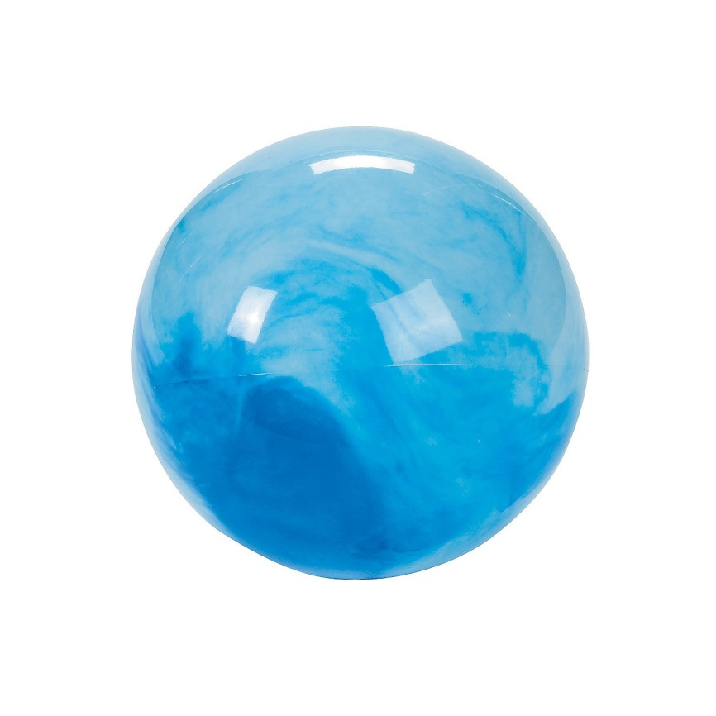
2.1 Skambalove
At the beginning of the game some of the players with the help of the teacher may try to explain the shape of the playing field and the marble. If you want to win, you have to make 36 points. Each participant must record and consider his score with the help of the teacher. The score of 36 points can be achieved by at least 12 shots per marble. Each participant can record how many times he throws the marble to make 36 and calculate how many rolls over the "Perfect Game" he has made.

